Slide 1
CEF440 · Mobile Programming Projects 2025–2026
TASK 5
UI Design & Frontend Implementation
BrainPath — Adaptive E-learning Platform
Weeks 9–10
[Member 1]
[Member 2]
[Member 3]
[Member 4]
[Member 5]
Notes:
Welcome slide. Introduce the team and confirm time allocation: ~5-7 minutes total, roughly 1 min per section.

Slide 2
Task 5 Overview
What we built this week
A fully functional, role-based frontend for BrainPath with integrated QoE monitoring that adapts content delivery in real time based on network and device conditions.
📱
⚡
🎯
🛠
3 role dashboards
QoE monitoring
Adaptive player
Full codebase
Student · Instructor · Admin
Passive + active hybrid
Video / Audio / Text
React + Tailwind + scripts
Notes:
Set the context. Task 5 was the bridge from design to visible product. Emphasise the four pillars shown on this slide before diving into detail.

Slide 3
Technology Stack
1
React.js (Vite)
5
Lucide React
Component-based UI · fast dev builds
Lightweight icons · low bundle size
2
Tailwind CSS
6
navigator.connection
Utility-first responsive styling
Passive network metric reading
3
React Router v6
7
Battery Status API
Client-side routing · protected routes
Low-battery adaptation trigger
4
Axios
HTTP client · auth token interceptors
Notes:
Briefly walk through the stack. The key point for the audience: all tools are free and open-source, and the last two (navigator.connection + Battery Status API) are the browser APIs that power our QoE monitoring without any server cost.

Slide 4
Role-Based Dashboards
Student
Instructor
Admin
Dashboard + QoE badge
Dashboard summary
Platform-wide stats dashboard
Course Catalog & search
Course Management (CRUD)
User Management (role, status)
Course View + adaptive player
Upload Content (MP4/MP3/PDF)
Adaptive Settings (QoE thresholds)
Quiz Page (timed, auto-mark)
Student Progress table
Reports stub (ready for backend)
Progress Report
Rate Content modal
Notes:
Each column = one actor from the use case diagram. Point out that ProtectedRoute in React Router ensures a student cannot access the admin pages and vice versa. This directly implements the role requirements from Task 3.

Slide 5
QoE Monitoring Service
How it works
Adaptation rules
BrainPath uses a passive + active hybrid approach to monitor network quality without taxing an already slow connection.
> 6 Mbps
720p video
Passive monitor
3 – 6 Mbps
360p video
Reads navigator.connection every 5 s — downlink, RTT, effectiveType, battery. Zero overhead, no requests.
1.5 – 3 Mbps
Audio only
Active speed test
< 1.5 Mbps
Text only
HTTP payload download every 45 s for precision throughput. Corrects drift in passive readings.
Battery < 20%
Audio only
Notes:
Key technical slide. Passive monitoring costs nothing — the browser already tracks these values. Active testing is the precision check. The five adaptation rules are directly configurable by the admin. Emphasise: all decisions happen client-side, no server round-trip needed.

Slide 6
Adaptive Content Player
ContentPlayer — the user-facing implementation
The ContentPlayer component reads live QoE state from QoEContext and automatically renders the right media element. Switching is seamless and preserves the student's playback position.
720p / 360p video
Audio only
Text transcript
🎬
🎵
📄
HTML5 video player
Good connectivity
Audio player
Poor connectivity or
low battery
Scrollable text
No connectivity
or < 1.5 Mbps
QoEBanner informs the student when a switch occurs and disappears automatically when conditions recover.
Notes:
Point out that the student never has to do anything manually. The system handles degradation transparently. The QoEBanner is the only visible signal — non-intrusive, informative, auto-dismissing.

Slide 7
UI Design Decisions
Every design decision traces back to our Task 2 survey findings.
1
Mobile-first layout
Sidebar collapses to bottom nav on small screens. Zero horizontal scroll.
2
Low visual complexity
Two-colour palette (teal + white/grey). Reduces GPU load on low-end Android devices with limited RAM.
3
Offline state awareness
Clear offline banner on all pages. Downloaded content stays accessible and is visually distinguished.
4
Accessible typography
14px minimum font size. WCAG AA contrast on all text.
5
Minimal data on load
Dashboards load JSON summaries first. Media is only fetched on explicit user action.
Notes:
Connect these back to the survey. Students said data is expensive, devices are slow, connectivity drops. These five decisions are the direct design response to those findings.

Slide 8
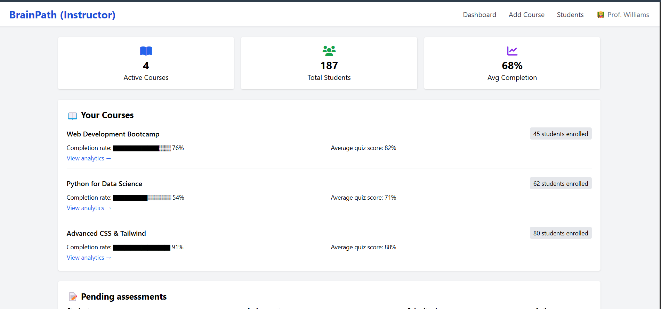
Application Screenshots
Application Screenshots: Instructor Dashboard
Notes:
Replace each placeholder box with an actual screenshot of the running app before the presentation. Demo: consider showing the live app if a projector and laptop are available — run npm run dev and walk through one student journey.

Slide 9
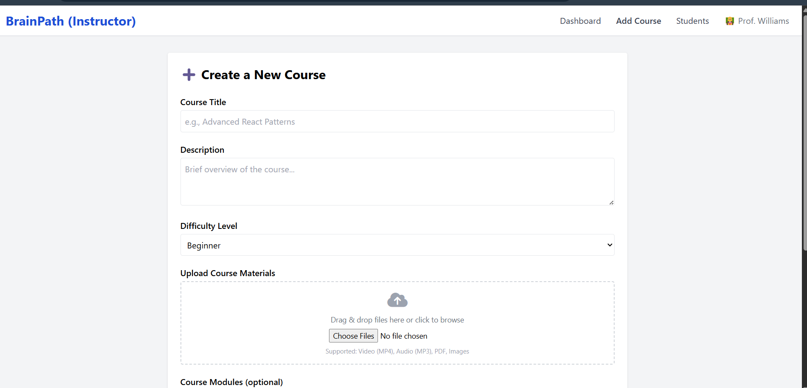
Application Screenshots
Application Screenshots: Instructor Course Creation Screen
Notes:
Replace each placeholder box with an actual screenshot of the running app before the presentation. Demo: consider showing the live app if a projector and laptop are available — run npm run dev and walk through one student journey.

Slide 10
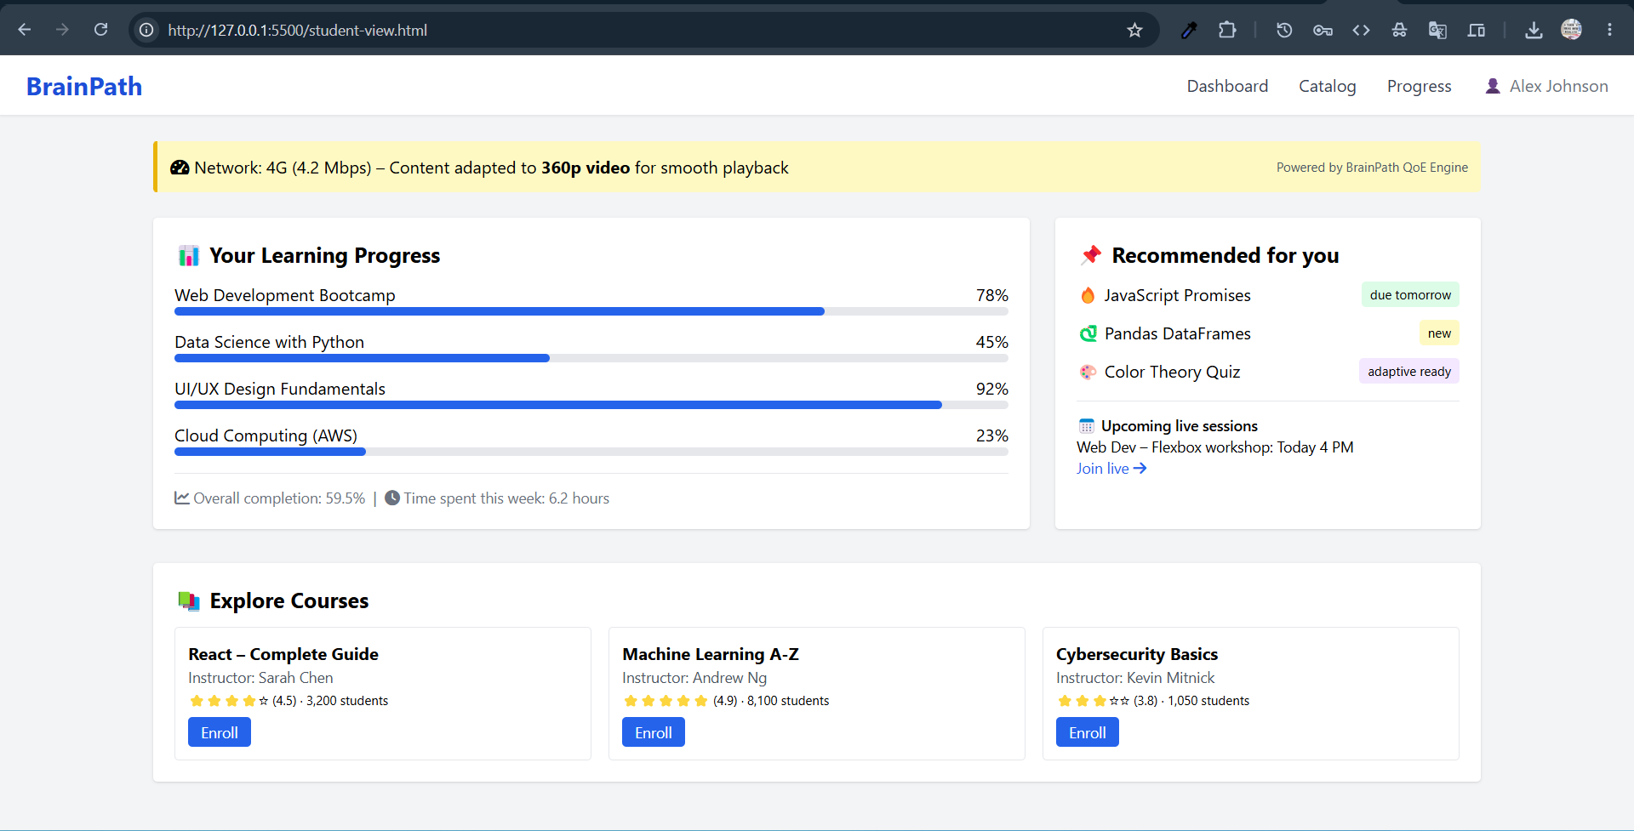
Application Screenshots: Student Dashboard
Notes:
Replace each placeholder box with an actual screenshot of the running app before the presentation. Demo: consider showing the live app if a projector and laptop are available — run npm run dev and walk through one student journey.

Slide 11
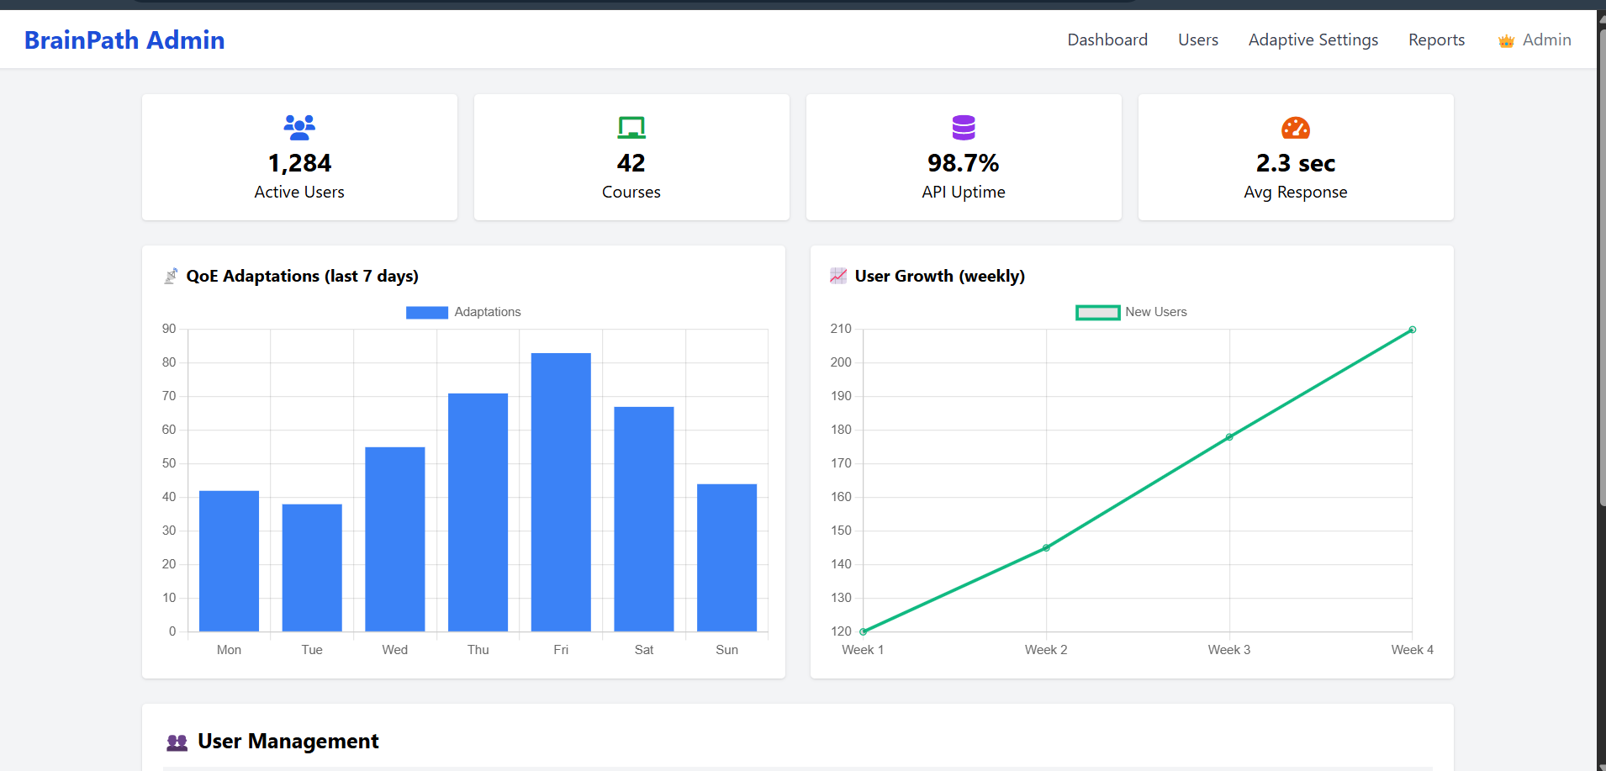
Application Screenshots: Admin Dashboard
Notes:
Replace each placeholder box with an actual screenshot of the running app before the presentation. Demo: consider showing the live app if a projector and laptop are available — run npm run dev and walk through one student journey.

Slide 12
Challenges & Resolutions
Challenge
How we solved it
Network monitoring overhead
Passive + active hybrid — navigator.connection costs nothing; speed test is only run every 30s .
Instant adaptation, no server wait
QoE engine is 100% client-side. Decisions made in milliseconds — no round-trip when connection is already degraded.
Offline downloads for PDFs
Download buttons on all content pages. Full IndexedDB video/audio caching deferred to Task 6.
Consistent design across 3 roles
Shared RoleLayout + single Tailwind config: one source of truth for spacing, colour, and typography.
Notes:
Show that the team anticipated problems and had principled solutions. Row 2 (instant adaptation) is the strongest technical point — emphasise it.

Slide 13
Deliverables & Next Steps
What we delivered
Task 6 — Database & Backend
✓
React + Tailwind CSS full frontend codebase
1
Define full DB schema (PostgreSQL / Supabase)
✓
qoeMonitor.js — PassiveMonitor + QoEEngine
2
Build REST API (Node.js/Express or Django)
✓
Adaptive ContentPlayer + QoEBanner
3
Replace all mock APIs with real endpoints
✓
Wireframes + component hierarchy document
4
Implement /api/speedtest.bin for active QoE
✓
5
Introduce WebSocket QoE telemetry to server
6
IndexedDB offline video + audio caching
7
UAT on real 2G / 3G / 4G networks
Notes:
Left = done. Right = coming next week. Use this slide to show progress continuity and that Task 5 is genuinely complete.

Slide 14
Task 5 complete.
BrainPath is live.
3
13
5
4
Role dashboards
Pages built
QoE rules
Adaptation modes
Next: Task 6 — Database Design & Backend Implementation (Weeks 11–12)
Questions?
Notes:
Closing. Invite questions. If the demo is available, offer to walk through one scenario: student logs in → bandwidth drops → ContentPlayer switches to audio-only → QoEBanner appears → bandwidth recovers → video resumes.

